Slide 1
From SPSS to R: why and how to make the transition
Ruam P F A Pimentel & Gregory J Meyer
The University of Toledo

Slide 2
Github
Setting up today’s environment

Slide 3
github.com/ruampimentel/SPSS_to_R

Slide 4
Agenda
First hour
Introductions and agenda (10 min)
Why R? (10 min)
Overview SPSS vs R (10 min)
Basic R programming (30min)
Second hour
Using Rstudio (20min)
What is a function and how to use them? (10 min)
Manipulating data, exploring descriptive and basic statistics SPSS vs R (30 min)
Third Hour
Data Visualization SPSS vs R (30 min)
How to read package documentation (15 min)
Exploring baseR cheat sheet (15 min)
Forth Hour
Supervised Practice – Let’s do it together (1 hour)
Import a new dataset
Check descriptive of variables
Run a t-test, ANOVA, or linear regression
Run Pearson’s correlation
Generate histograms, scatterplots, and bar graphs.

Slide 5
Goal
Use basic R functions to manipulate data, run descriptive statistics, run common statistical analyses, and visualize data.
Explore R resources and make use of R community member forums so they can keep learning and improving their skills.
Read documentation for R packages so you can learn new packages and troubleshoot your syntax.

Slide 6

Why R

Slide 7
Why R – Main arguments
Free, open source, and available on every major platform.
Diverse and welcoming community.
A massive set of packages for statistical modeling, machine learning, visualization, and importing and manipulating data.
Incredible versatile:
Rmarkdown (HTML, PDF [my cv], Word, Power Point, dashboard)
Shiny (HTML, Javascript) - example
RStudio, the IDE, provides an integrated development environment, tailored to the needs of data science, interactive data analysis, and statistical programming.
A strong foundation of functional programming. “Lego bricks”
Source: https://adv-r.hadley.nz/introduction.html#why-r and https://bookdown.org/ndphillips/YaRrr/why-is-r-so-great.html
Notes:
SPSS – paid. Very academical focused. Hard to switch to industry.
SPSS – You might find some community in ResearchGate, but not much active, take too long to reply.
SPSS – What You See Is What There is – WYSIWTS. Pre made packages and analysis, not much flexible, unless you really spend hours and hours with the very specific SPSS syntax.
SPSS – A bunch of copy and pasting to produce final manuscript.
SPSS – Multiple open windows, you have to jump windows by windows to find the info you want. If you are like me, and like to see, data, syntax and output at the same time, you have to have at least three screen monitor, or a really big monitor.
SPSS - Limited support to data analysis. Best example is the addition of Cohen’s d. Such a basic stat to calculate effect in one of the most basic analysis: t-test. If that is my environment, I’m get comfortable, and don’t feel the need to spend. In R you can process and analyze text, use stats to construct ML models, and keep learning new analyses. Fish can swim equally in a lagoon or in the ocean, but I bet they can explore more in the ocean (as they might become food easier as well hehe).
If you thought about something, you can build it. You have the tool. Now just put them together.

Slide 8
Problems
Much of the R code you’ll see in the wild is written in haste to solve a pressing problem.
Compared to other programming languages, the R community is more focused on results than processes.
Inconsistency is rife across contributed packages, and even within base R. You are confronted with over 25 years of evolution every time you use R, and this can make learning R tough because there are so many special cases to remember.
Source: https://adv-r.hadley.nz/introduction.html#why-r

Slide 9
R community
Twitter: #Rstats
StackOverflow: My Question Interaction example
Rstudio/Posit community: website
Many Cheatsheet… (later)

Slide 10
SPSS vs R
SPSS | R
Typically, only one way to get a specific result | Many different ways to get the same result! (it should not scare you)
Give you a few options on what you can see in your result. | Flexible – you have to be specific
Result lies in the output – your output is important! | Result lies in your syntax – your syntax is important!
Input (data) and output (output files with results and tables) are different things. If you want to manipulate your output you have to use OMS and transform it in a new input. | Input and output are the same things: view or object Imagine all your output from SPSS gets automatically converted into new datasets using OMS.
Notes:
# 2 SPSS - Like a fast food that only have those options of food, and you don’t have many options to make a special request.
# 2 R - You either have to give the full order specifying everything you want in your order. Or you are the chef, and will make your food from scratch, but EXACTLLY as you like it.

Slide 11
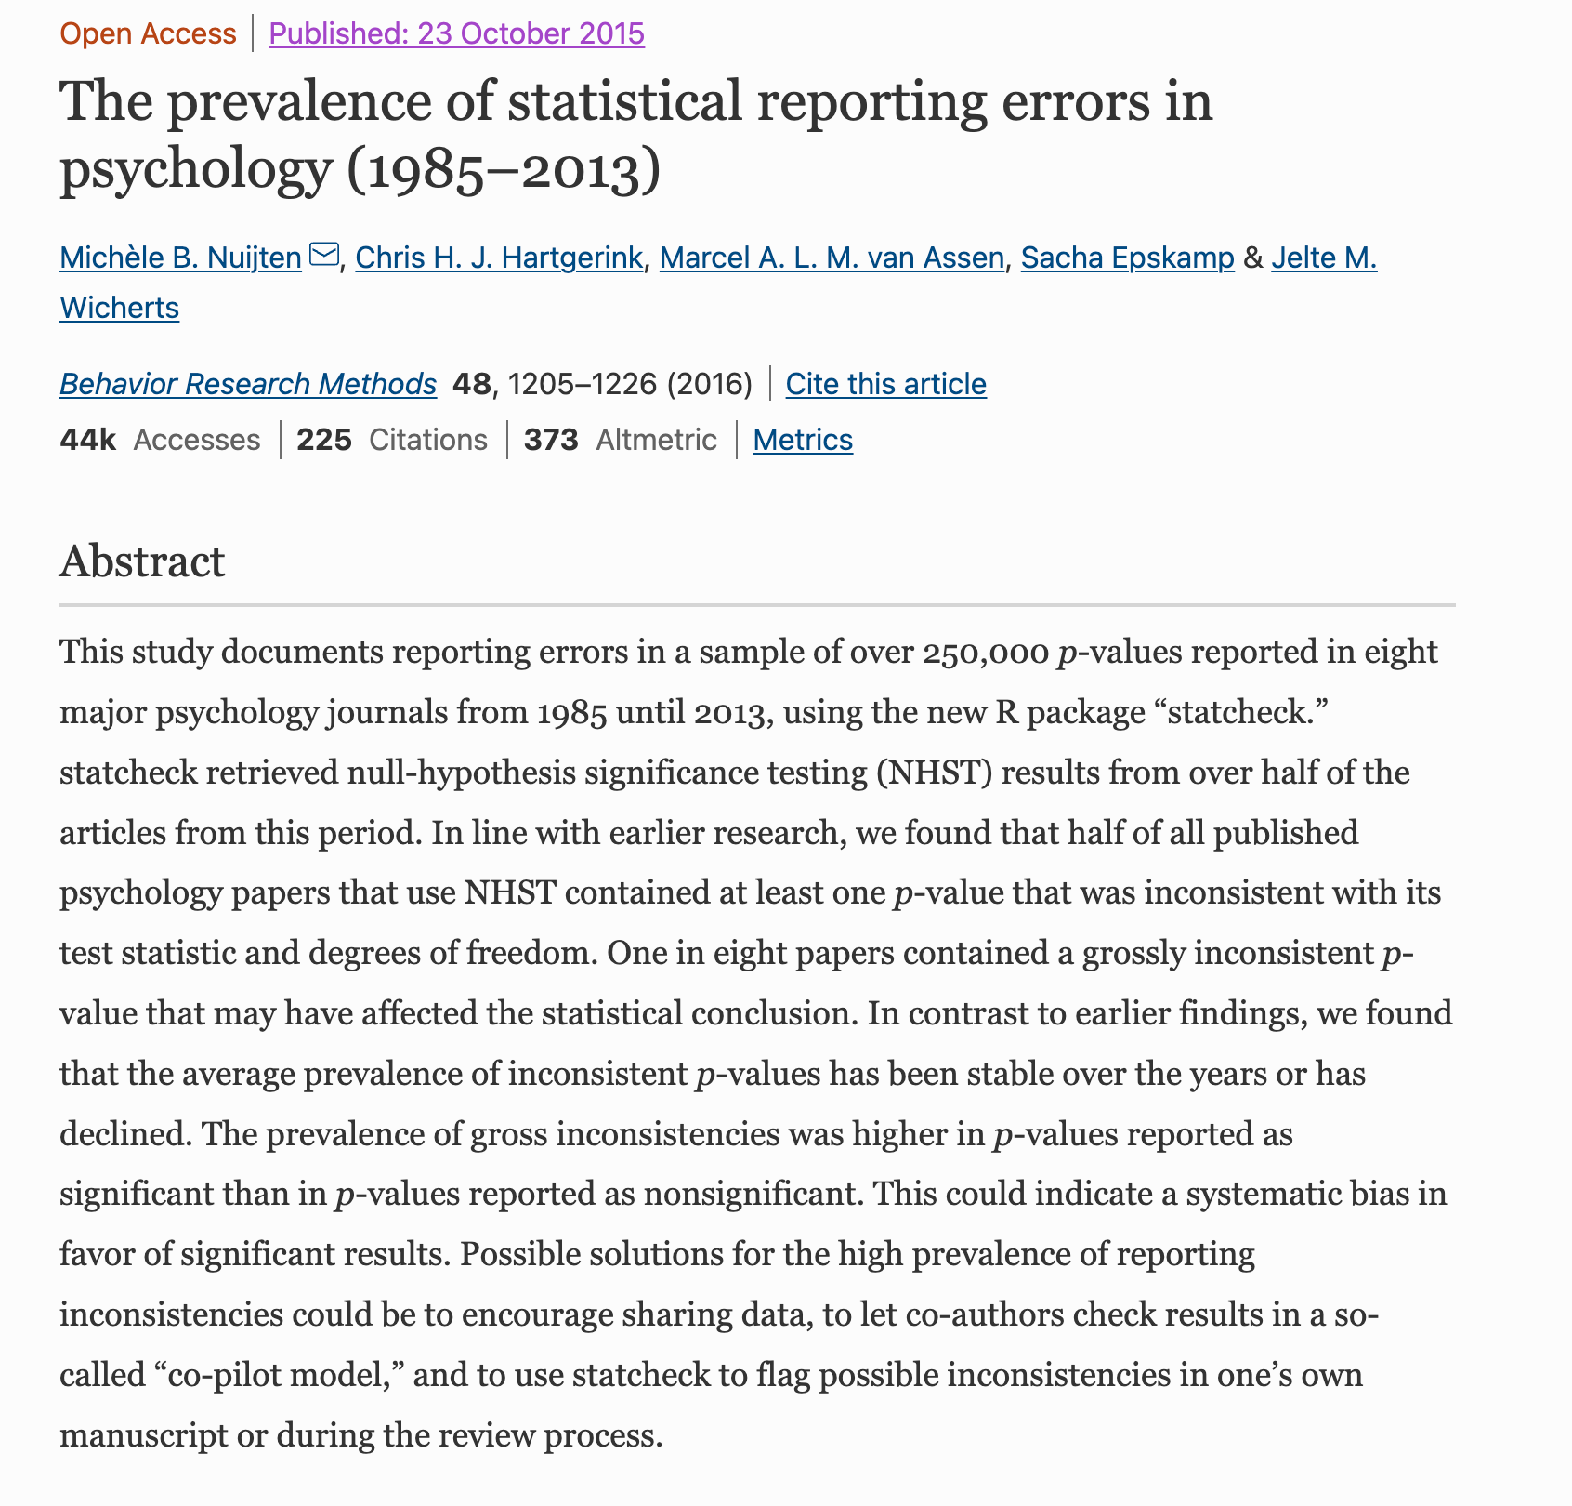
Notes:
Copying and pasting problem

Slide 12
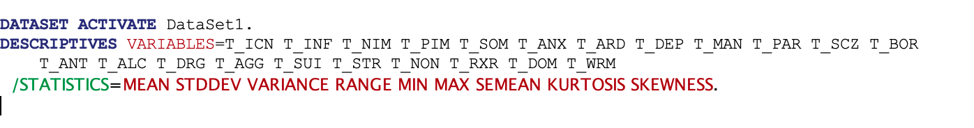
SPSS Syntax comparison
SPSS syntax
R Syntax
pai %>%
select(T_ICN:T_WRM) %>%
describe()
Notes:
After SPSS syntax, you still have to copy and paste
After R syntax, if you want, you already have the final version to export and put in your MS.

Slide 13
R – Showcase

Slide 14
Rstudio - Showcase

Slide 15

Syntax
From zero to 2 – basic stuff. We will see everything.
Everything else is ‘free stuff.’ We can focus on what makes more sense now together, and the rest, you all can practice by yourself.
Correlation, regression, t-test, ANOVA,

Slide 16
Basic R
Object orientated Language
Notes:
What ‘object orientated language means?’

Slide 17
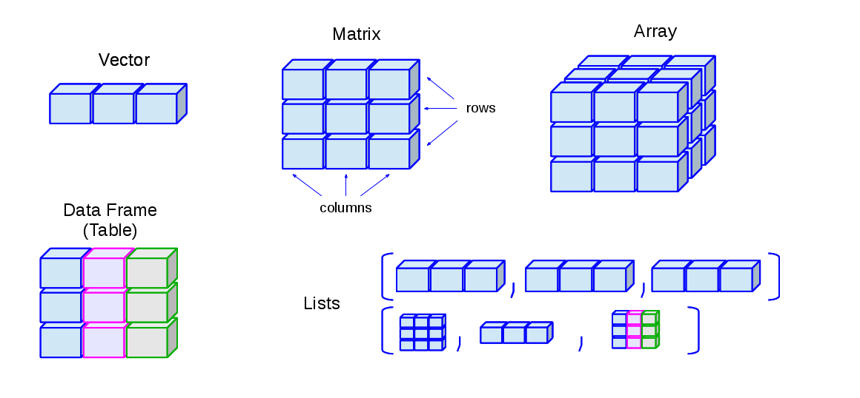

Data Types | Data Structure
Source: http://venus.ifca.unican.es/Rintro/dataStruct.html
Notes:
Datasets with Psychological data, most of the time, are DATA FRAMES. In which each column is a a different variable, sometimes numeric, characters (words and sentence)

Slide 18
Basics types
4.5 is a decimal value called numerics.
4 is a natural value called integers. Integers are also numerics.
TRUE or FALSE is a Boolean value called logical binary operators in R.
The value inside " " or ' ' are text (string). They are called characters.
Source: https://www.guru99.com/r-data-types-operator.html

Slide 19
Create new variables / objects
First (and recommended) way to declare a variable: use the `<-`
name_of_variable <- value
Second way to declare a variable: use the `=`
name_of_variable = value
Third weird and not common way:
value -> name_of_variable
Bonus:
assign("name_of_variable", value)

Slide 20
R file 00_basic_r.R & 00a_factors.R

Slide 21

Base R and Package Datasets

Slide 22
Base R and Package Datasets
Pre-loaded datasets that you can call at any moment, even though you don’t ‘see’ them in your environment.
Common datasets:
iris
mtcars
cars
Replicate problems or teach functions in R. Everyone has already access to them.
Other packages also gives you pre-loaded datasets. Examples:
dplyr = starwars
psych = bfi
Notes:
-Given you will see these datasets a lot in your R journey, I thought you could already learn about them here.

Slide 23
Functions

Slide 24


Functions
Like a mixer, an oven, and other kitchen appliance.
Input
Processing
Output
(garbage in, garbage out)
Notes:
Input
Each appliance require a specific input
E.g., mixer = peal fruits,
E.g., toster = the slice of a bread
usually, we don’t put bread in the mixer and fruit in the toaster
Processing
The mixer Mix
The toaster toast
The oven bake…
Output
You already know what you will get from each of the appliances.
We put fruits in the mixer and we anticipate to get a juice or a smoothie at the end, depending on the ingredients,
We don’t anticipate getting a toster from the mixer
Function are the same thing!
‘ingredients’ are called ‘arguments’
Each function does a specific thing: read the manual! After getting used, we don’t have to keep reading the manual. Just like me learning to use the rice machine.
Each function gives a SPECIFIC output. If the manual says a function gives a vector as output, don’t expect getting a dataframe, or a list. Or vice-verse.

Slide 25
Functions
Basic question: what does this function do?
What is the input of this function?
E.g., vector, data frame, list, .csv, .xlsx?
What is the required arguments of this functions?
Variable names with or without quotations
What are the default of this function?
E.g., TRUE or FALSE arguments? remove missings (na.rm = T)?
What is the output of this function?
E.g., vector, data frame, list, image, pdf, excel, csv, png…?
Notes:
Info you need to know about each function you use:

Slide 26
00b_basic_r.R & 01_data_frames.R

Slide 27
Packages

Slide 28
Packages
Like apps in your phone. Examples:
Text message – Communication by text
Communication by video
Edit photo
If you want to use the app functionality, you have to install the app in your phone. And you only install one time. Right?
install.packages(“pkg_name”)
Then, every time you want to use the app in your phone you have to ‘open the app.’
library(“pkg_name”)
Sometimes you are not using the app but it is still open in the background ‘ready to work’
Notes:
Like apps in your phone
Text message – Communication by text
Built in app
WhatsApp
Telegram
Messager (facebook, Instagram) – not built for this, but gives a very similar result
Email – slightly different operation, but similar result
Communication by video
Facetime
Whatsapp
Facebook/Instagram
Zoom, WebEx, Google Meet… (do people use that on their phone? – we can)
Edit photo
Phone basic editor
Many different apps to edit photos
In your browser (it was not made for it, but it gets the job done)

Slide 29
Packages
Reading package documentation
Google ’dplyr R documentation’ – look for cran.r-project link
Package Manual vs. Vignettes
Examples in help
CRAN vs GitHub vs e-book
Cheatsheet – if better for you, print them!
RStudio – help() / ? / F1: CRAN

Slide 30
Packages - debugging
You will find packages with different names with functions with the same name, doing different things!
Problem of a ‘free environment’ anyone do whatever they want, and call it whatever they want.
But no worry, R has a beautiful solution. Just specify which package you want to use.
Common problem with filter()from dplyr.
stats::filter()
dplyr::filter()
OR
Hmisc::describe()
psych::describe()
When different packages have functions with the same name, the last loaded package with ‘mask’ previous functions.

Slide 31
Debugging

Slide 32
Debugging
Get used to it
Resources:
Package manual
Cheatsheets
Stack Overflow
ChatGPT (free) / Copilot

Slide 33
Packages conclusion
Learning R is not about ‘learning R’
Learning R is about learning packages.
Remember: Each package is like a different app in your phone.
Do you say you learned ‘iOS’ or ‘Android’?
For sure you know your way around iOS or Android. But you have to learn each app, and eventually you have your favorite apps, or apps that at least ‘gets the job done.’

Slide 34
Tidyverse
A package of packages
Imagine Microsoft Office, or Apple environment, or Google workspace, and now, TIDYVERSE!
A life style, or better, a data science style

Slide 35
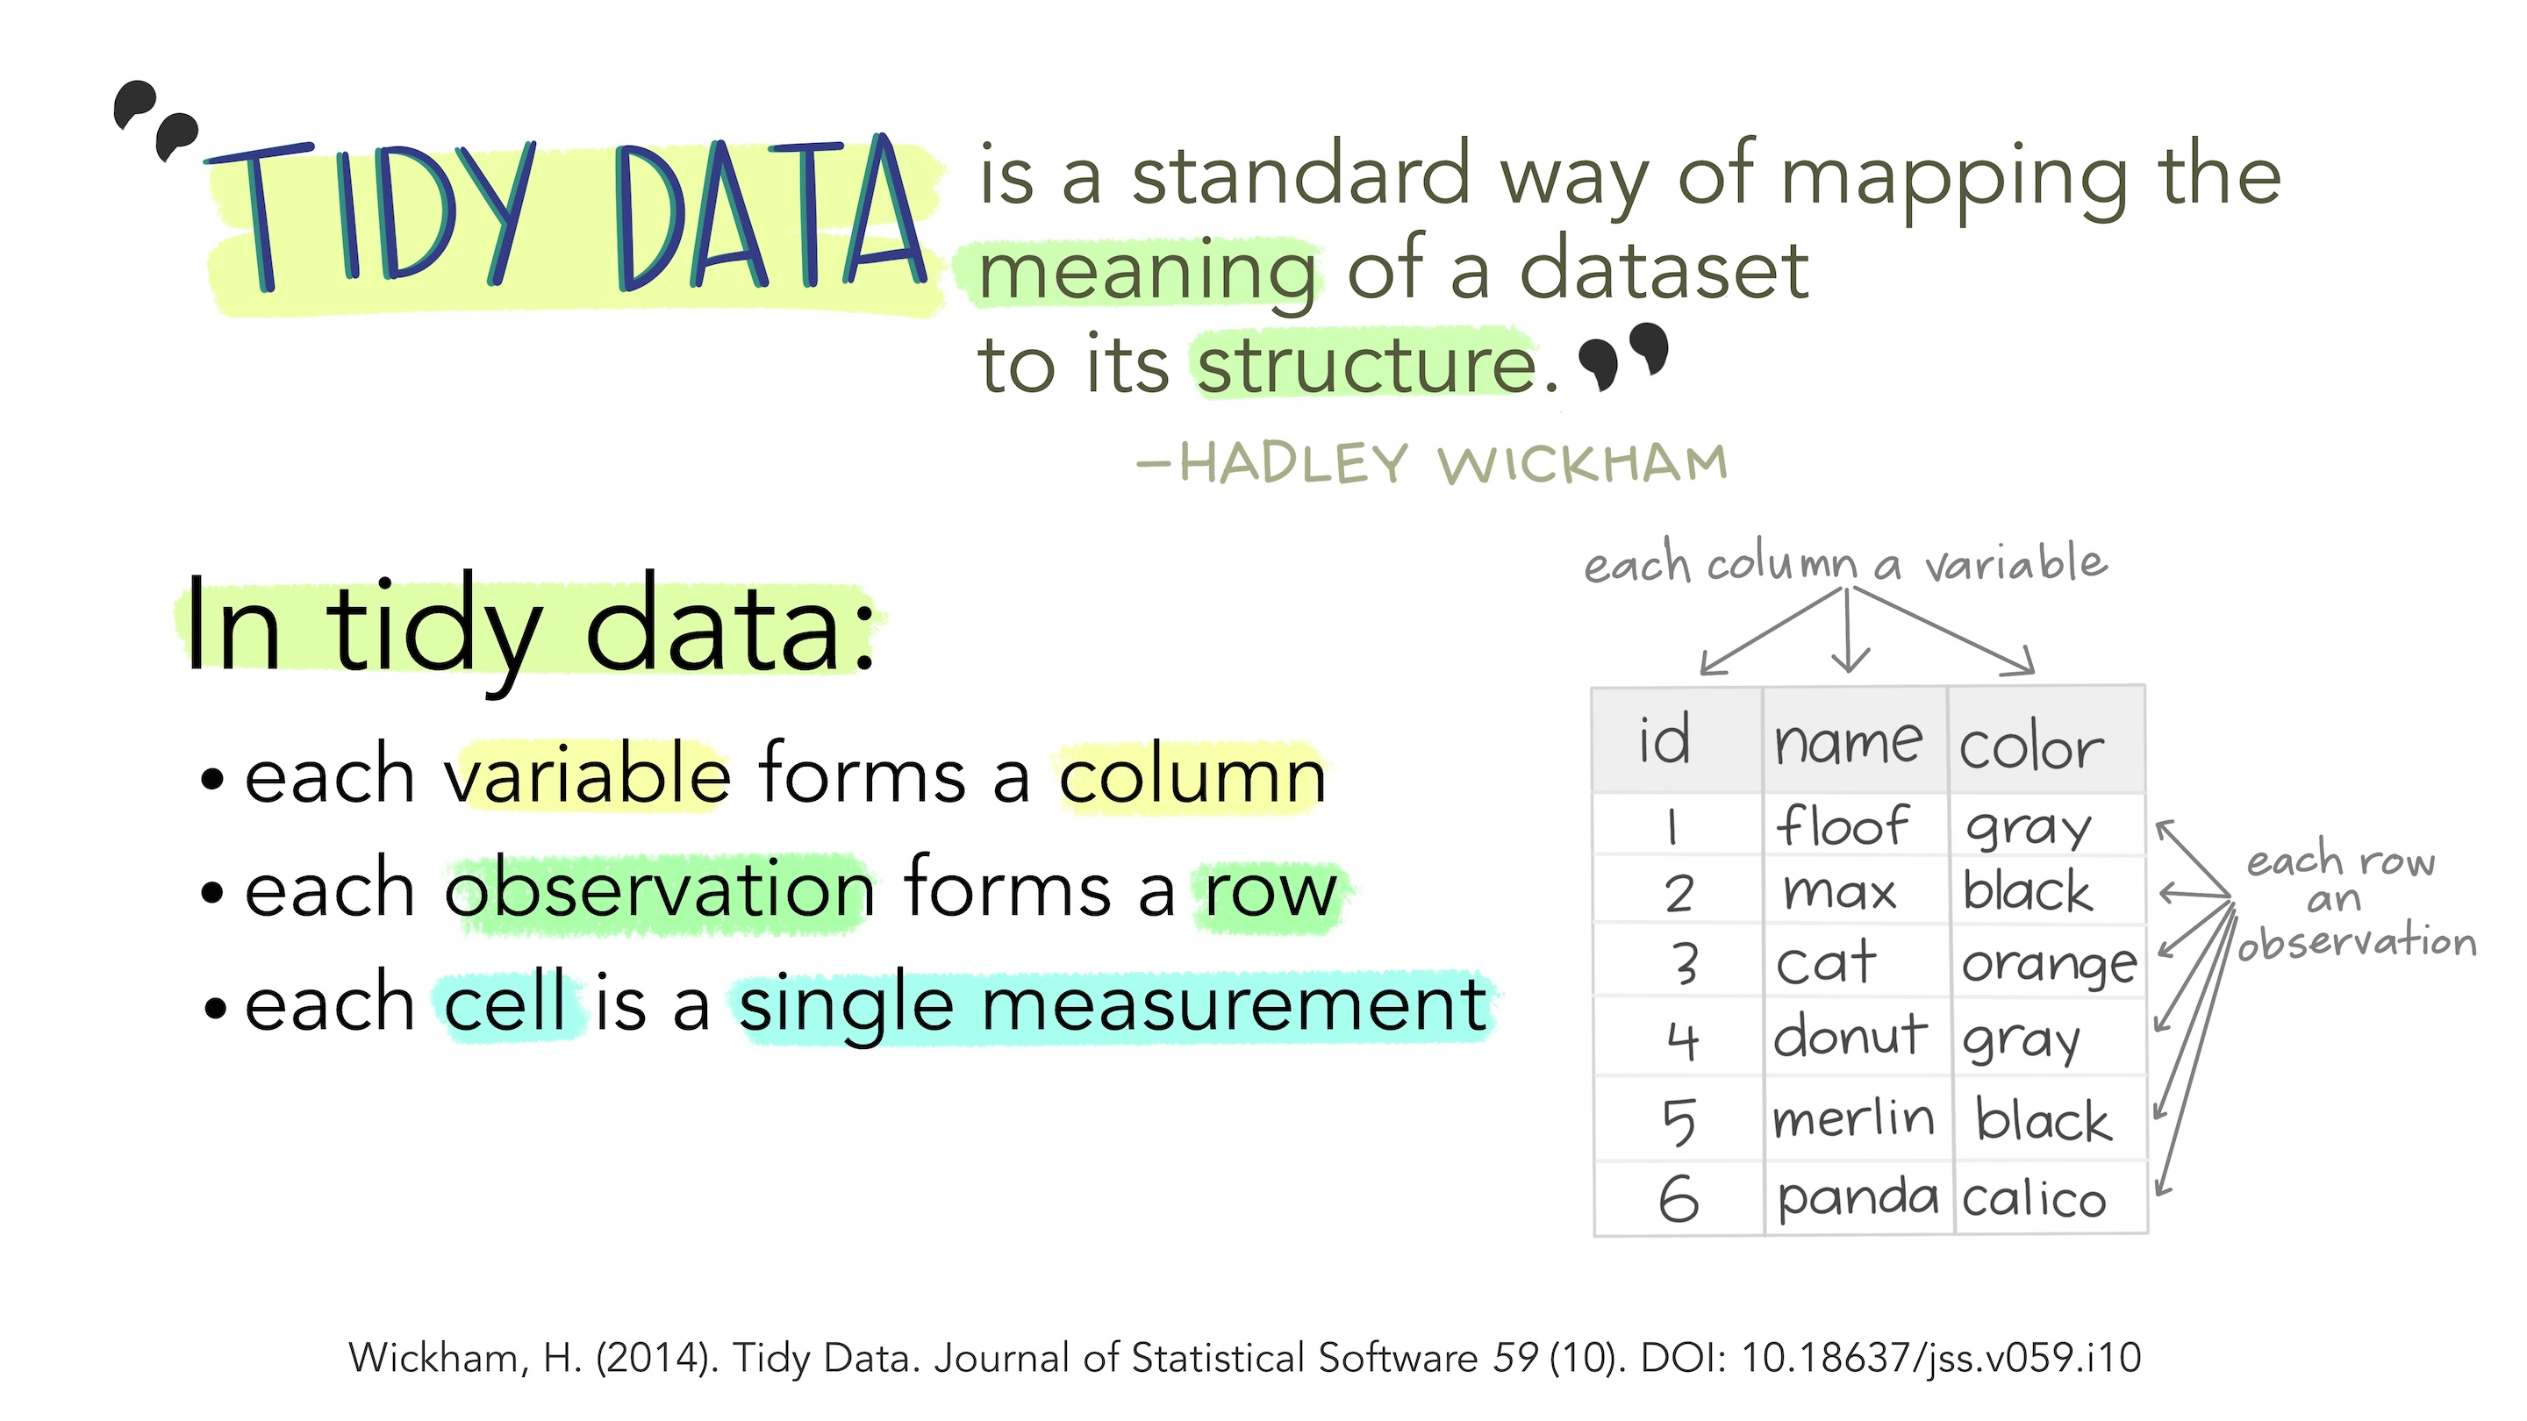
Art: Horst, J. L. A. A. (2020, October 12). Tidy data for efficiency, reproducibility, and collaboration. https://www.openscapes.org/blog/2020/10/12/tidy-data//

Slide 36
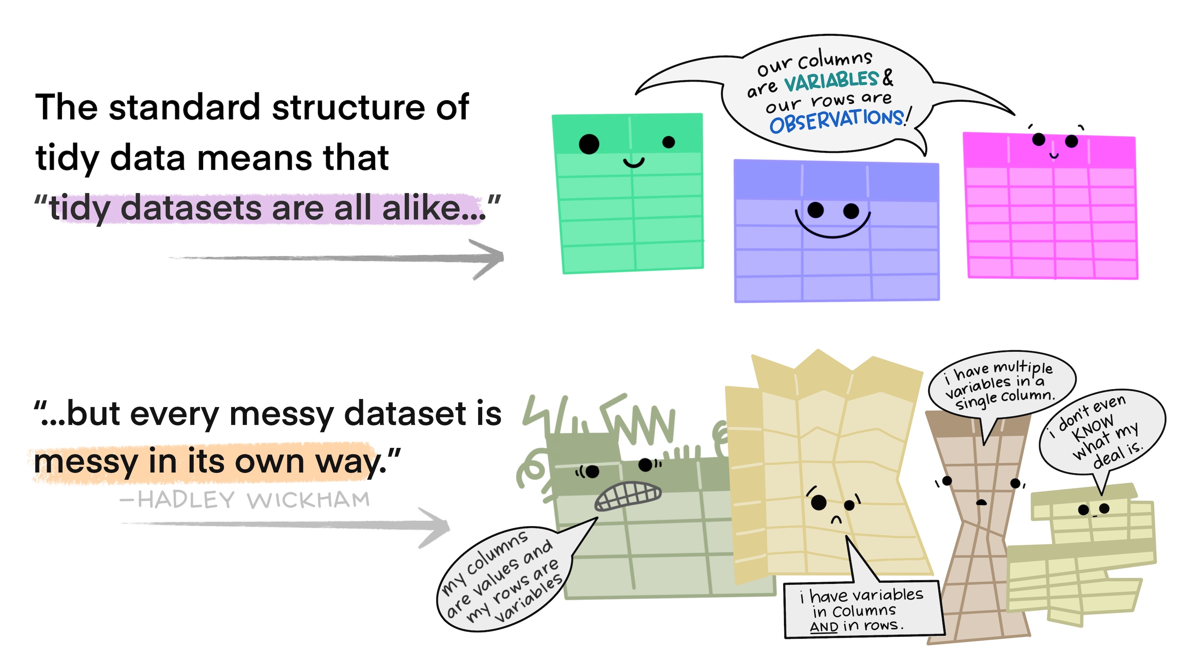
Art: Horst, J. L. A. A. (2020, October 12). Tidy data for efficiency, reproducibility, and collaboration. https://www.openscapes.org/blog/2020/10/12/tidy-data//

Slide 37
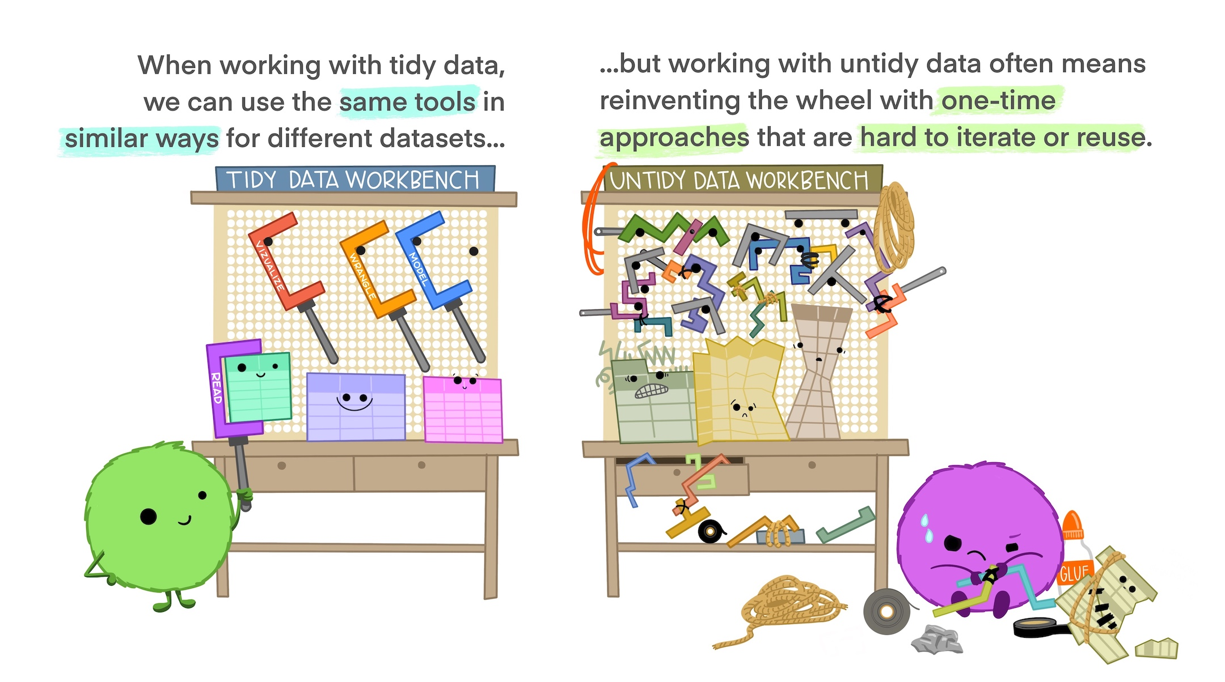
Art: Horst, J. L. A. A. (2020, October 12). Tidy data for efficiency, reproducibility, and collaboration. https://www.openscapes.org/blog/2020/10/12/tidy-data//
Notes:
Tidy data allows you to be more efficient by using existing tools deliberately built to do the things you need to do, from subsetting portions of your data to plotting maps of your study area. Using existing tools saves you from building from scratch each time you work with a new dataset (which can be time-consuming and demoralizing). And luckily, there are a lot of tools specifically built to wrangle untidy data into tidy data (for example, in the tidyr package). By being more equipped to wrangle your data into a tidy format, you can get to your analyses faster to start answering the questions you’re asking

Slide 38
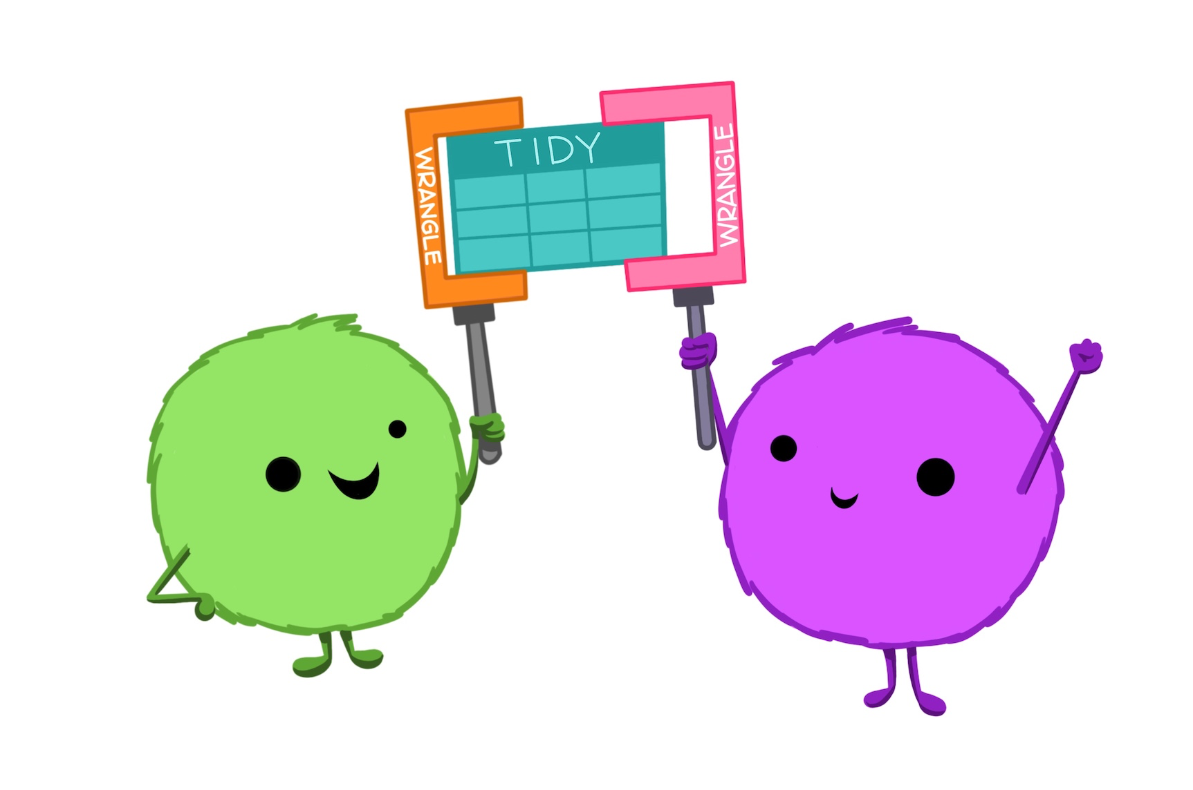
Notes:
Tidy data makes it easier to collaborate because our friends can use the same tools in a familiar way. Whether thinking about collaborators as current teammates, your future self, or future teammates, organizing and sharing data in a consistent and predictable way means less adjustment, time, and effort for all.

Slide 39
Tidyverse – core packages
https://www.tidyverse.org/packages/

Slide 40
Data Cleaning – Data manipulation

Slide 41
dplyr Basics
Key dplyr functions. Solve the vast majority of your data manipulation challenges:
Pick observations by their values: filter()
Reorder the rows: arrange()
Pick variables by their names: select()
Create new variables with functions of existing variables: mutate()
Collapse many values down to a single summary: summarise()
Can be used in conjunction with group_by(). Changes the scope of each function:
From: operating on the entire dataset
To: operating on it group-by-group.
Source: https://r4ds.had.co.nz/transform.html

Slide 42
dplyr basics
These six functions provide the verbs for a language of data manipulation. All verbs work similarly:
First argument: data frame.
Subsequent arguments: describe what to do with the data frame, using the variable names (without quotes).
Result: a new data frame.
Together these properties make it easy to chain together multiple simple steps to achieve a complex result.
Source: https://r4ds.had.co.nz/transform.html

Slide 43

Hands-on

Slide 44
Hands-on
From now on, it is completely hands-on!
I will show what I typically use, but there are many other ways to do the same things, as many other apps in the apple store or android store, but you only use a few dozens.
Everything I’m going to show you now, you can learn BY YOURSELF.
It is basically, reading manuals.
My focus here is to give you resources so you can keep learning and improving your R skills. At the same time, I also want to give you some good ‘recipes’ that already work, and you can already make a cake, although it will not a be a fancy cake. As you keep studying, your will soon start baking fancy cakes!

Slide 45

ggplot2
Grammar of Graphs

Slide 46

Source: https://www.udemy.com/course/r-programming/learn/lecture/4721396#learning-tools

Slide 47
Grammar of the Graph
The data being plotted
The geometric objects (circles, lines, etc.) that appear on the plot
A set of mappings from variables in the data to the aesthetics (appearance) of the geometric objects
A statistical transformation used to calculate the data values used in the plot
A position adjustment for locating each geometric object on the plot
A scale (e.g., range of values) for each aesthetic mapping used
A coordinate system used to organize the geometric objects
The facets or groups of data shown in different plots
Source: https://uc-r.github.io/ggplot_intro

Slide 48
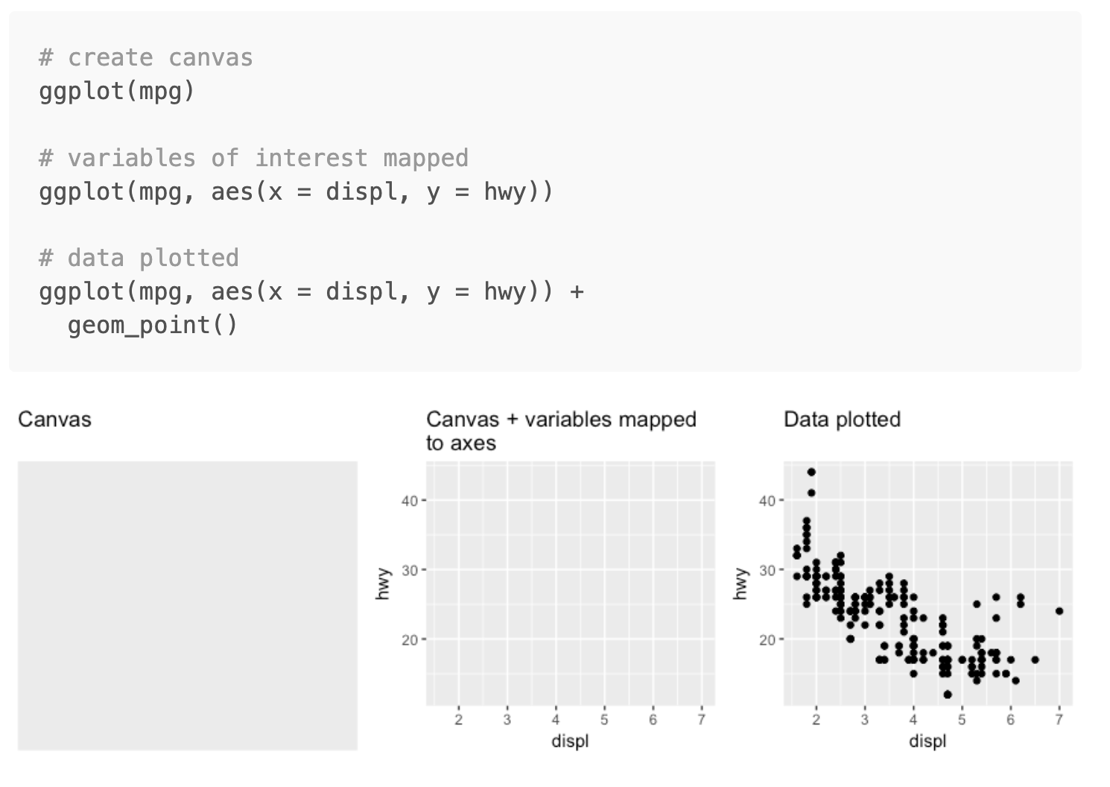
Source: https://uc-r.github.io/ggplot_intro

Slide 49
File 11_basic_ploting_ggplot2.R
Resource: https://r-graph-gallery.com/

